Slide 1
Managing Remote Sales Team:
Keep things on track during the pandemic
Benjamin Rempe, COO
May 11, 2020

Slide 2

Agenda
What are we talking about?
    LenderClose
    Sales philosophies
    Shift to “remote” sales
    Tools
    Super send-off

Slide 3
LenderClose
LenderClose empowers credit unions and community banks by equipping mortgage and home equity originators with workflows and solutions required to provide efficiencies and shorten the lending cycle through meaningful integrations.

Slide 4
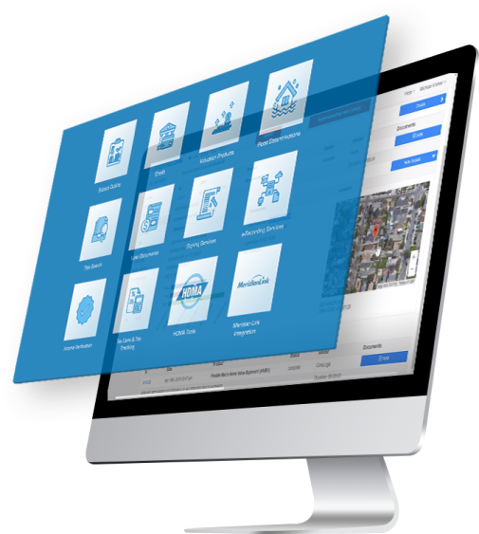
What is LenderClose?
Speed
Efficiency
Borrower
Experience

Slide 5
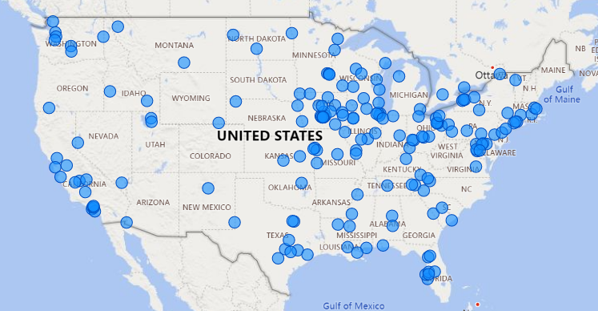
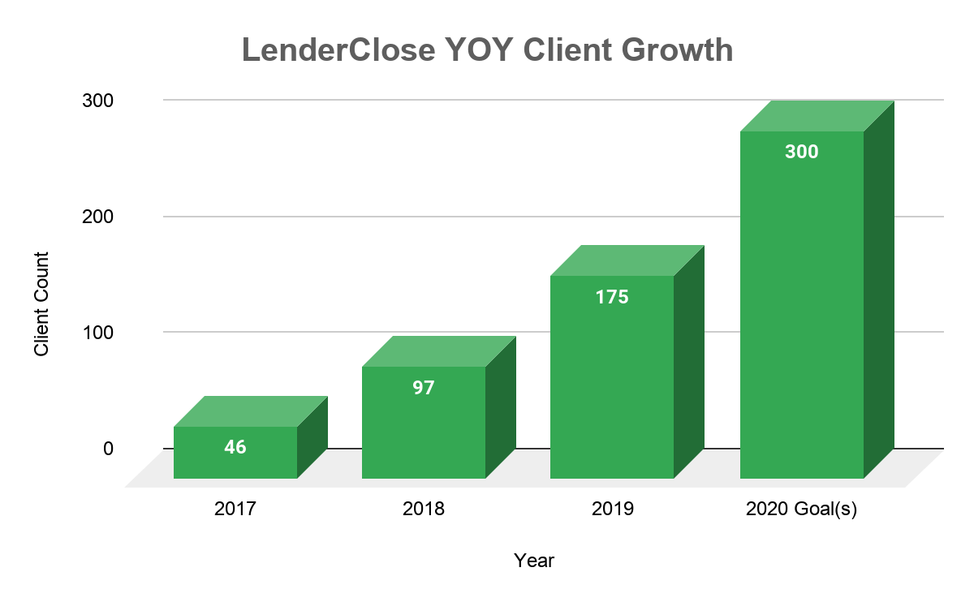
LenderClose Growth Pattern & Projections

Slide 6
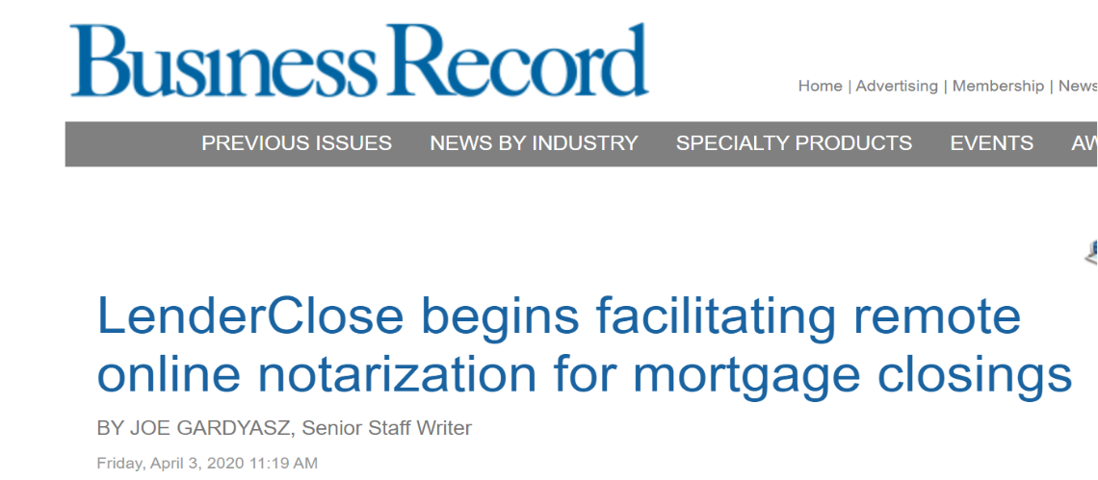
LenderClose RON technology
Remote online notarization (RON): LenderClose makes history
First RON transaction in the history of Iowa
First mortgage closing via RON transaction in the state

Slide 7
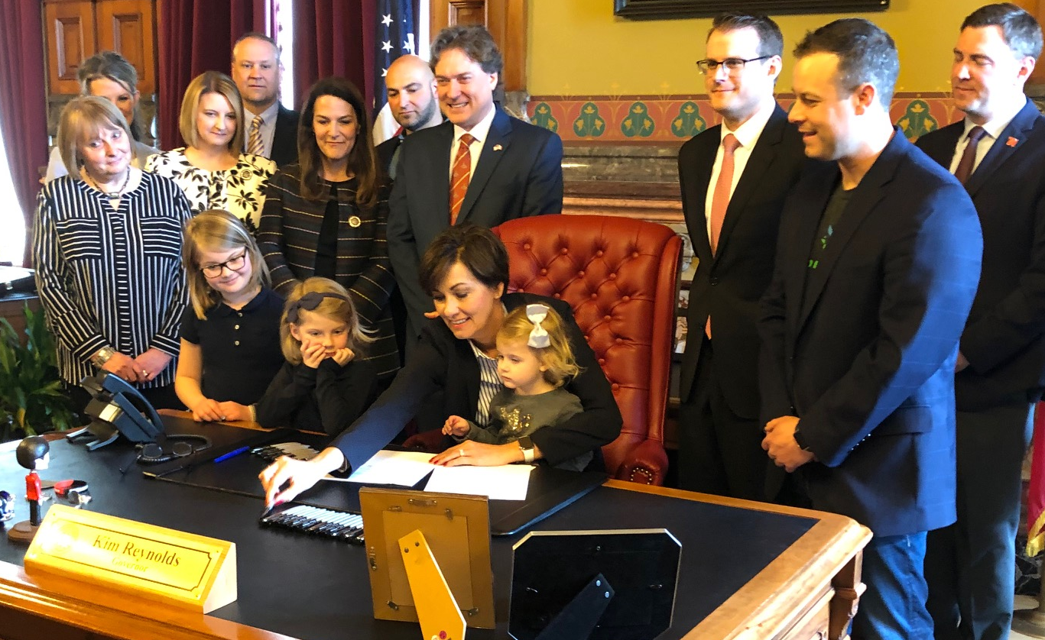
LenderClose RON technology

Slide 8
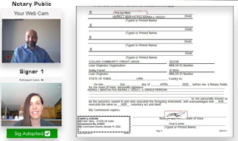
LenderClose RON technology

Slide 9
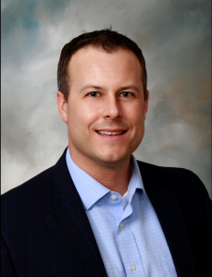
LenderClose
Hey, that’s me!
    LenderClose COO
    Sales and sales management entire career
    Mortgage, commercial and credit card lending
    At my core, I’m a lender

Slide 10
Sales Philosophies
Sales philosophies are incredibly important. Knowing what type of company you want to be will help you stay focused. Knowing who you are will stop you from making big mistakes down the road.
This is who we are.

Slide 11

Sales Philosophy #1
Your company is worth $0 if you can’t sell
    What if it’s the best idea ever?
    No, seriously, it will change the world.
    No, you don’t understand, my idea/product/solution/service is the best.
Doesn’t matter, still worth $0

Slide 12


Sales Philosophy #2
Build a culture
    Inside sales
    Resume doesn’t matter
      Energy
      Attitude
      Growth mindset
This Photo by Unknown Author is licensed under CC BY-SA

Slide 13
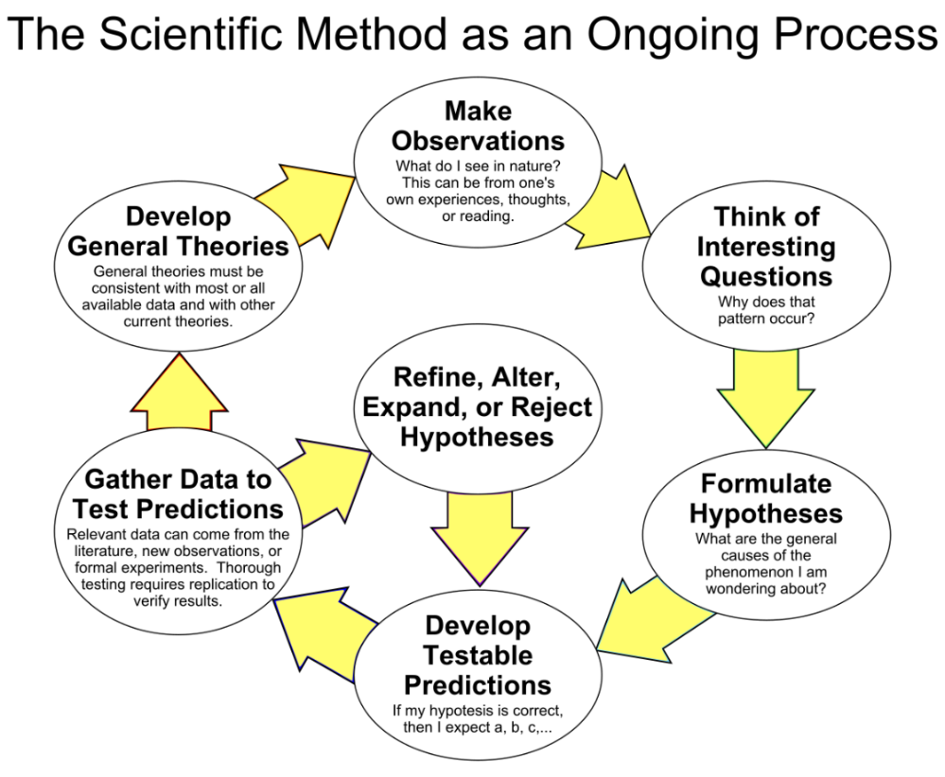

Sales Philosophy #3
This Photo by Unknown Author is licensed under CC BY-SA

Slide 14

Sales Philosophy #3
Process
    Know your landscape
    Be present
    Monitor activities
    Learn
    Coach behaviors

Slide 15
Shift to “Remote” Sales
LenderClose has always done prospecting and deal-closings “remotely”, however, everyone was always in the office. It was inside sales, not remote sales. Coronavirus changed everything.

Slide 16
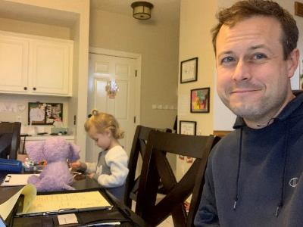
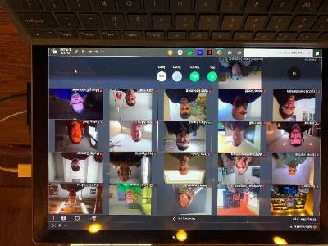
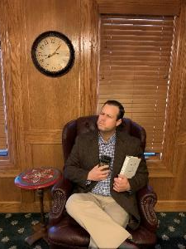
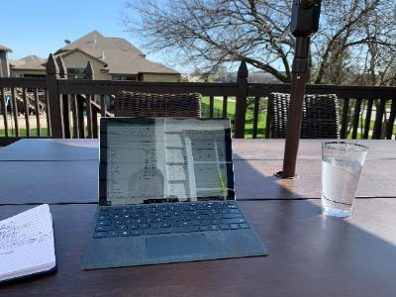
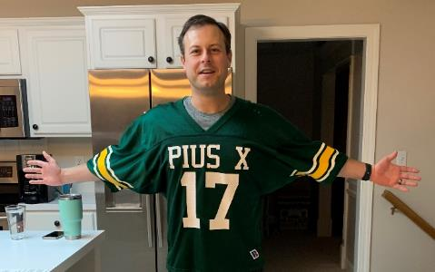
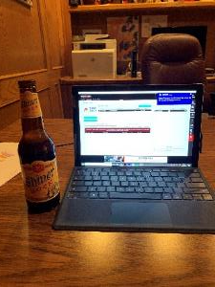
Timeline
When it was time to move, we moved quickly:
  March 6 – Let the board know we had a plan if the team needed to be moved to WFH. Didn’t think it would be necessary until big employers made the move.
  March 10 – It felt like the virus was spreading quickly, decided to make the move on Friday, March 13.
  March 11 – In the morning, I wrote up the memo to the team to be distributed March 13 and boarded a plane.
  March 11 – Landed in Chicago, ghost town. Surreal experience. Decided on the spot to send everyone home immediately. In DSM, the team packed up their stuff, cleaned their surfaces and headed home.
  Two weeks later, partners started asking what our plan was for disaster recovery. Fun to tell them we had been executing for two weeks and they didn’t know!

Slide 17


Some things have changed
Miss the face-to-face interaction
    No water cooler talk
    Utilizing Slack
    Smaller group meetings
This Photo by Unknown Author is licensed under CC BY-NC-ND

Slide 18
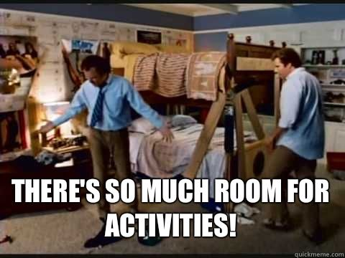
Some things have not changed
Philosophies have not changed!
    Still must sell
    Intentional about culture!
    Energy
    Attitude
    Growth
    Process and activities

Slide 19
Tools
These are a few tools we use to manage our process.
LenderClose breaks out our sales team into acquisition and account management. Both equally important.
To say I obsess about process is an understatement.

Slide 20
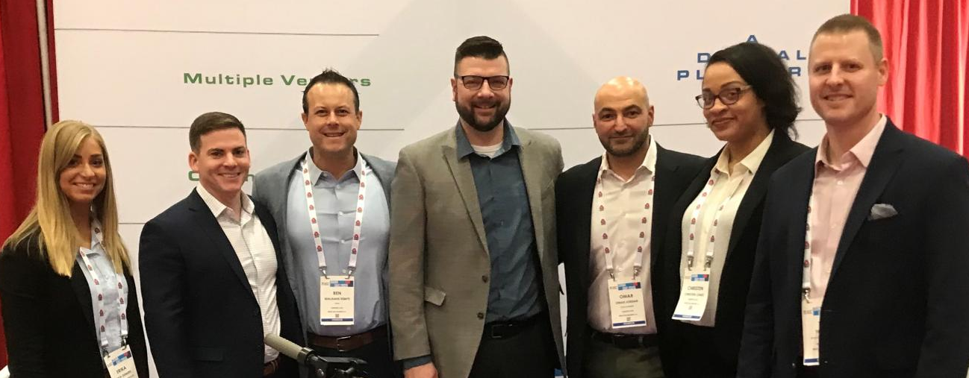




Acquisition Tools

Slide 21

Account Management Tools
(Virtual) hugs not handshakes
    Make a friend
    Do something for them
    Ask them to do something for you
Year over year growth
  (-) churn rate

Slide 22


Account Management Tools
Key performance indicators (KPIs)
    Over forty metrics; including:
      Revenue per client
      Products per client
      Products per order
      Orders per day
      Revenue per order
  All numbers our team can impact

Slide 23

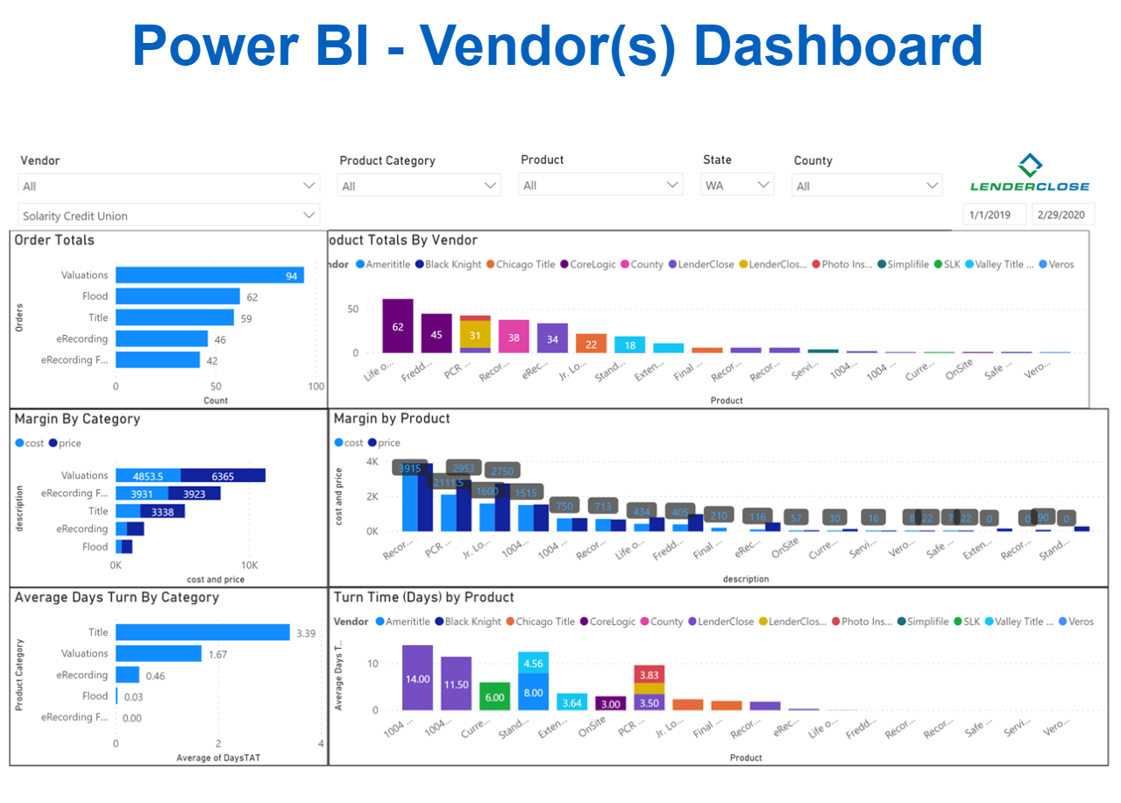
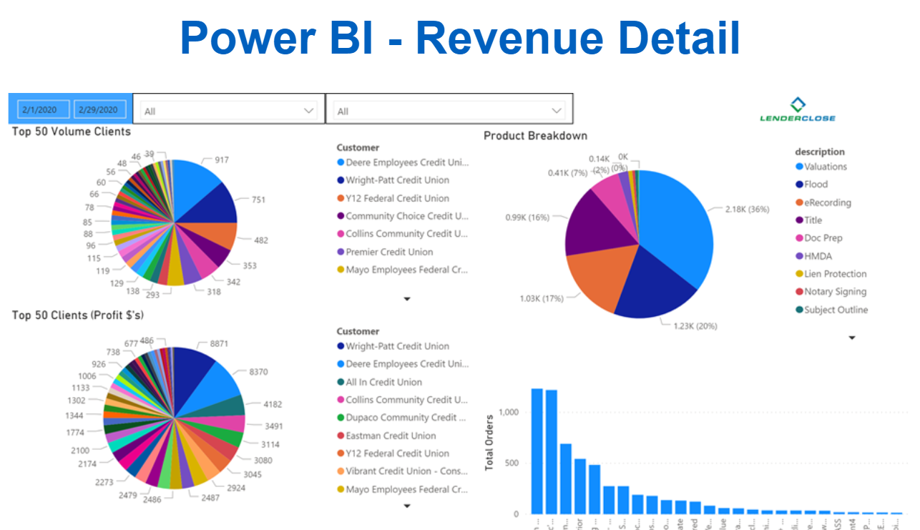
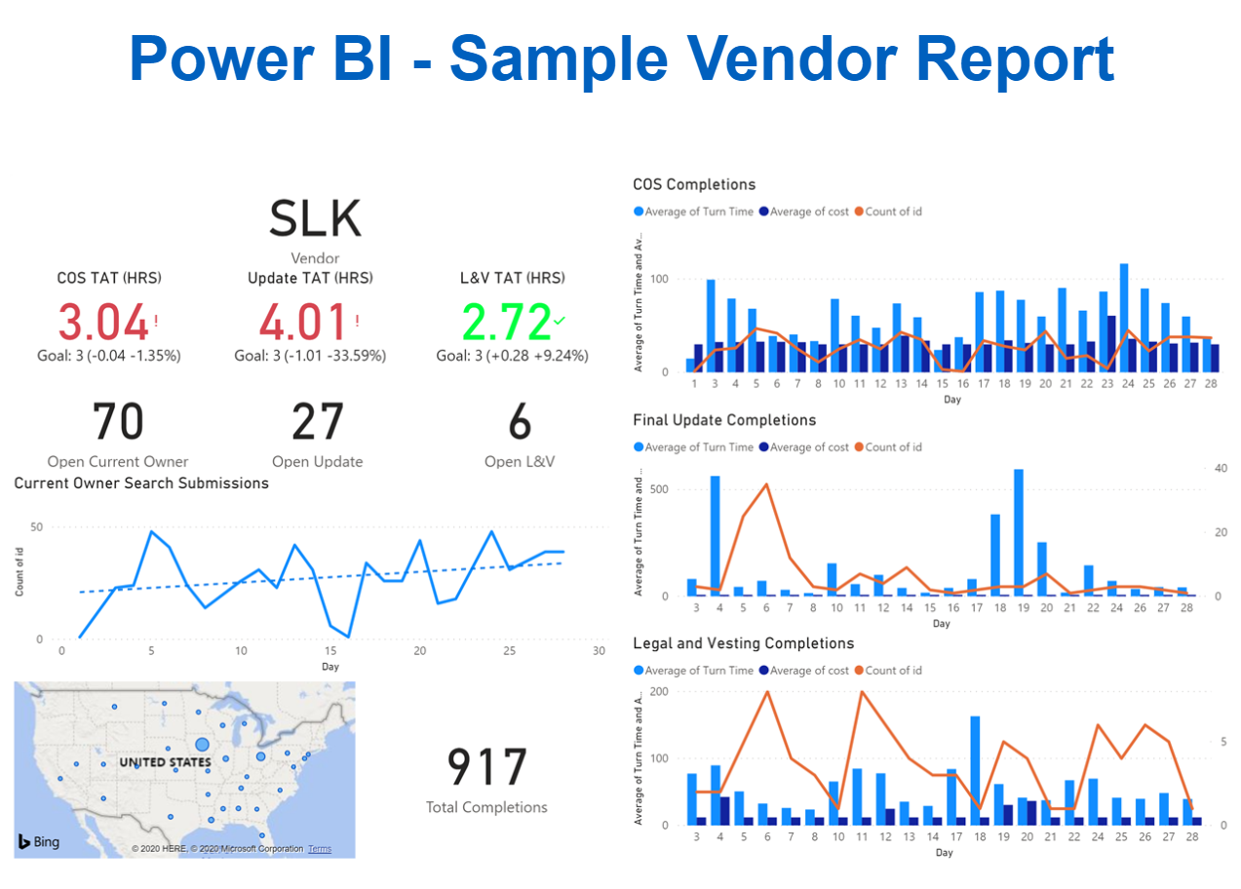
Account Management Tools
Microsoft Power BI: Data Visualization
    Vendor and user dashboards
    Vendor, user, and revenue reports

Slide 24
Super Send-off!
Go do it. No excuses. Right now, no tomorrow.

Slide 25

Super Sendoff!
All GREAT Sales Teams:
    Have URGENCY
    GREAT Collaborators
    PROCESS Oriented
    Outstanding COACHES
    YOU can do it
This Photo by Unknown Author is licensed under CC BY-NC-ND
Notes:
Have a sense of urgency = no sales = no value
Great collaborative culture - intentionally built fostered
Have a process
Coach efforts and abilities

Slide 26


The end?
Questions, please.
Thanks for sitting through my sales seminar. I accept Venmo.*
@benjaminrempe
*I don’t really accept Venmo, but that is my very inactive twitter handle.
Also, find me on LinkedIn: https://www.linkedin.com/in/benrempe/
www.orchardplace.org/donation

